Slide 1
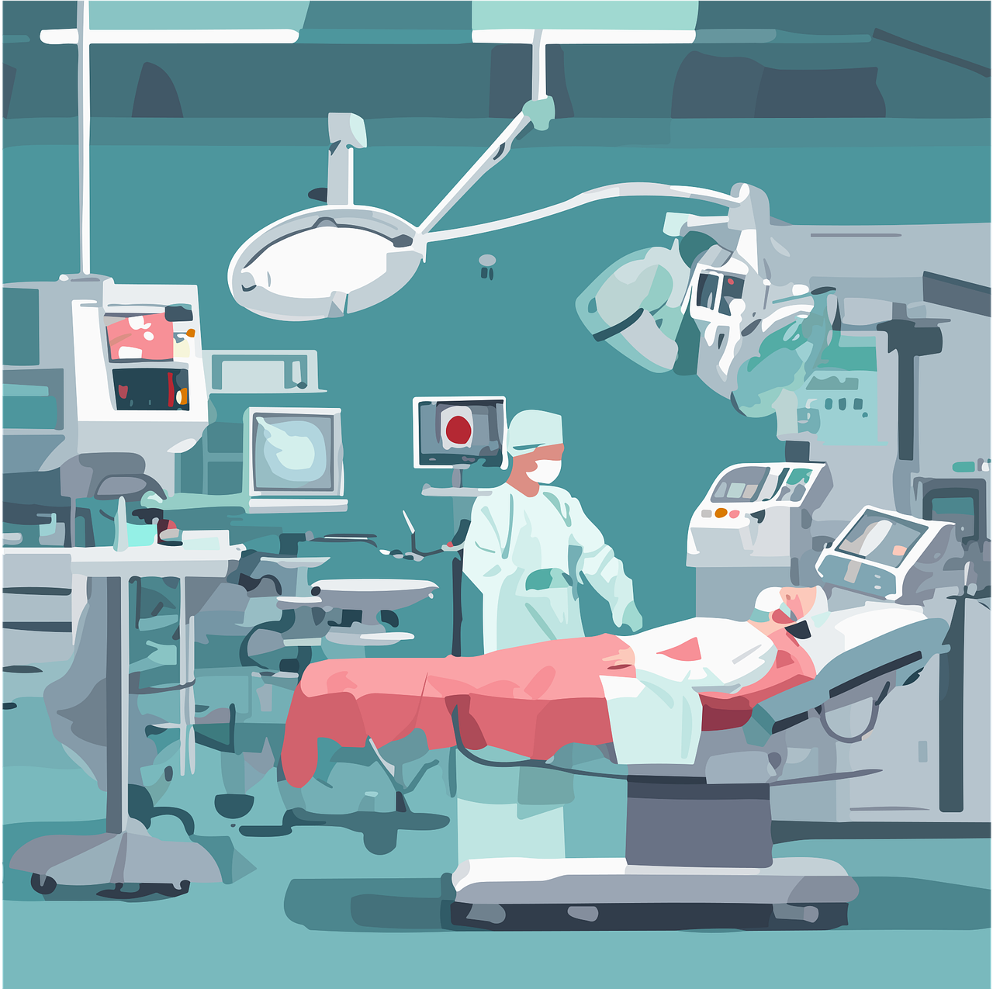
Future of Large Language Models and Digital Twins in Precision Healthcare: A Symmetric Literature Review
Neel Shah, Dr. Nirav Bhatt, Dr. Nikita Bhatt

Slide 2
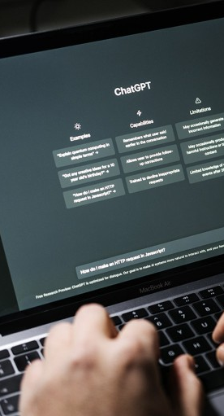
What Is Meant By The Term ‘Large Language Models’?
Large language models (LLMs) are deep learning models that are trained on extremely large datasets of text and are capable of multiple natural language processing tasks, such as translation, summarization, report-making, and grammar correction. By learning which word (or token) is most probable to appear after a sequence of preceding words in a self-supervised manner, the LLM is able to predict the next single word and is therefore described as generative.
Diverse applications of LLMs have appeared in the healthcare industry, including facilitating clinical documentation, creating discharge summaries, generating clinic, operation, and procedure notes, obtaining insurance pre-authorization, summarizing research publications, or working as a chatbot to answer questions for patients with their specific data and concerns.
LLMs can also assist physicians in diagnosing conditions based on medical records, images, and laboratory results and suggesting treatment options or plans. At the same time, patients can potentially become more autonomous than with prior search methods by obtaining an individualized assessment of their data, symptoms, and concerns.

Slide 3
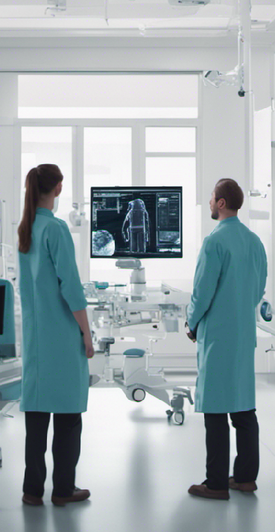
What Is Meant By The Term ‘Digital Twin’?
The Digital Twin(DT) is a virtual replica of a product or system throughout its life cycle, Digital twins provide learning, reasoning, and dynamic recalibrating for improved decision-making using real-time data and other sources.
They are intricate computer models that can be modified, changed, and updated in real-time and are twins, or exact reproductions, of real-world things.
Digital twins can be used for various purposes, such as patient care, clinical studies, better personal health, diagnostics and medical training, health forecasting, better clinical research methods, identifying the best treatments and many more.
Beside this comprehensive simulation and being equipped with AI, the DT is able to uncover information, including system descriptions, hidden patterns, and unknown correlations. The ability to record, control, and monitor the conditions and changes of the physical system allows for the application of AI predictive and prescriptive techniques for forecasting failures, testing the outcome of possible solutions, and activating self-healing mechanisms.

Slide 4
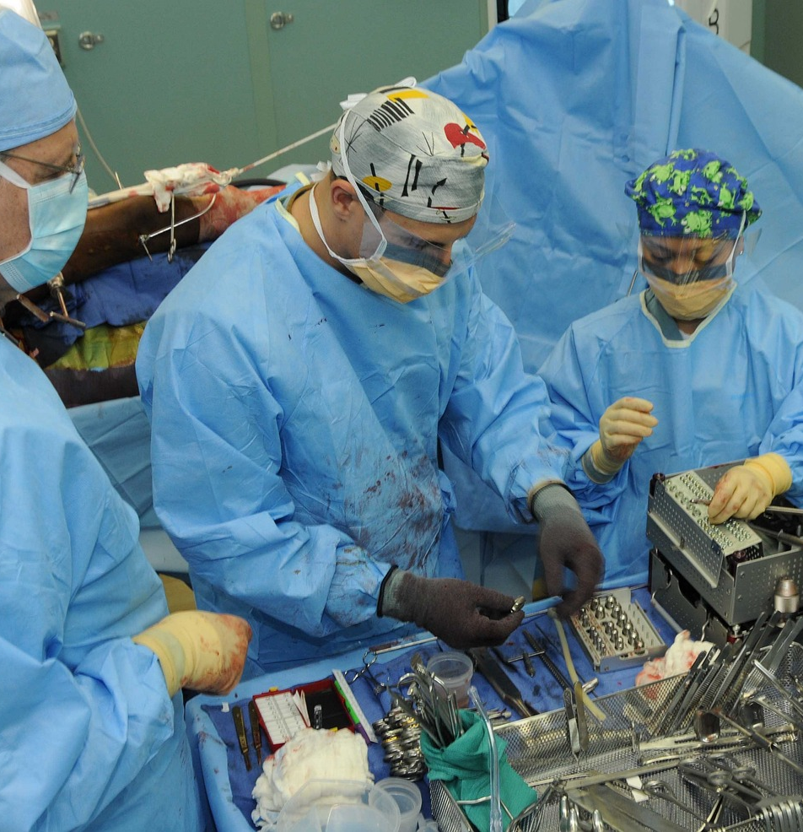
The Current Scenario In The Health Care
In current scenario of the healthcare, For verification of the any drug or vaccine human trials are carried out, But this trails can be harmful for the human beings if that specific drug malfunctions.
In the current world there are technologies which can predict the survivability in case of different cancers, but there is no technology which can give the personalized recommendations regarding it and also there is no virtual space where experimentation with different conditions can be made for making the survivability longer.
And also there exists the models which can predict the dosage requirement for radiation therapy but there exists no models or technologies which can suggest the personalized change in the therapy as per the immune system of different patients.
And solution to this and other hundreds of the problems in healthcare, specifically precision healthcare is our proposed state-of-the-art technology.

Slide 5
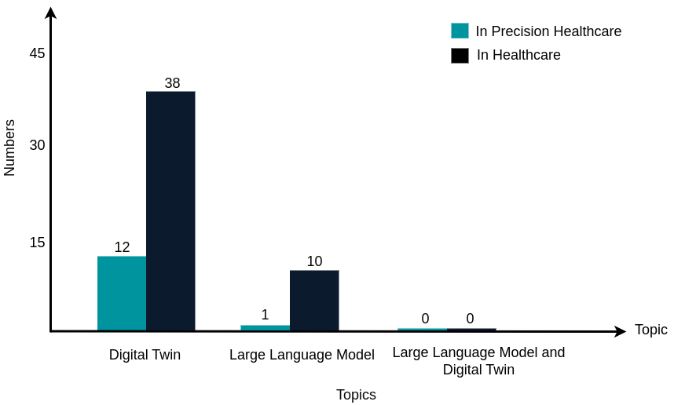
From Where Does This Idea Of Combinational Technology Came From?
At the start of the work, the we identified three unique research questions that guided the entire review:
RQ1: Which are the state-of-the-art LLMs in the field of precision healthcare, and what are their applications?
RQ2: Which are the state-of-the-art digital twins in the field of precision healthcare, and what are their applications?
RQ3: Is there any literature that relates to the combinational use of LLMs and digital twins in the field of precision healthcare?
And while finding answers to this research questions we came across an research gap, which have the potential to revolutionize the entire healthcare industry, And that is our proposed technology.

Slide 6
What’s The Proposed Technology?
Our proposed state-of-the-art technology is the technology which is combination of the large language model and digital twin, And By help of this one can communicate with the digital twin model of the specific patient and one can also ask the questions to that model and can also ask the model to make the changes in it according to the description given in the prompt given by user, And by help of this technology a direct communication can be established with the digital twins.
An example application of proposed technology can be like connecting the digital twin of the heart of an patient to a large language model like chatGPT, And by which one can make different questions to the digital heart model like what is the condition of the any part of the heart, Or is there any problem to the heart which is transferring the blood from one part of heart to another, Or how are the heart’s valves are performing and one can also ask the heart to produce an report on condition of heart like is there any anomalous activity occurring in heart like tightening or leaking in the heart’s valve(Structure that allow the blood to flow from one chamber to another chamber or blood vessel), Or Is there any problem of blockages in any part of the heart?
By help of this proposed technology, healthcare professionals can easily understand and communicate with the complex digital twins, Which is currently tedious job and requires the usage of complex software and high skills in both the computer science and healthcare domain.

Slide 7
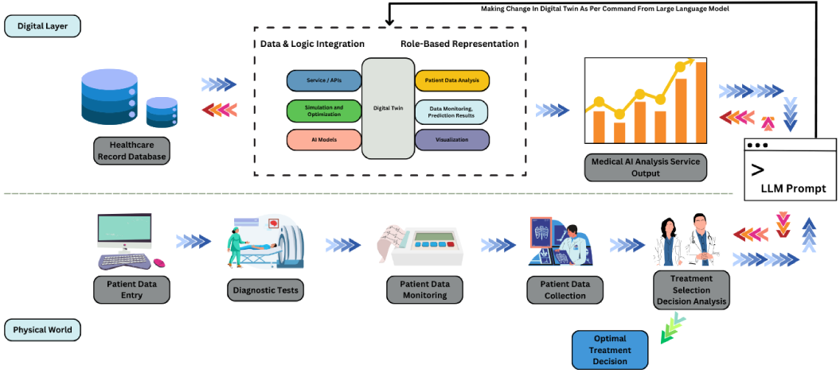
The Architecture Of Proposed State-of-the-art Technology
Further, this technology can also be extended for the treatment of critical diseases in patients. A demonstration of our proposed technology in precision healthcare is shown in figure below.

Slide 8
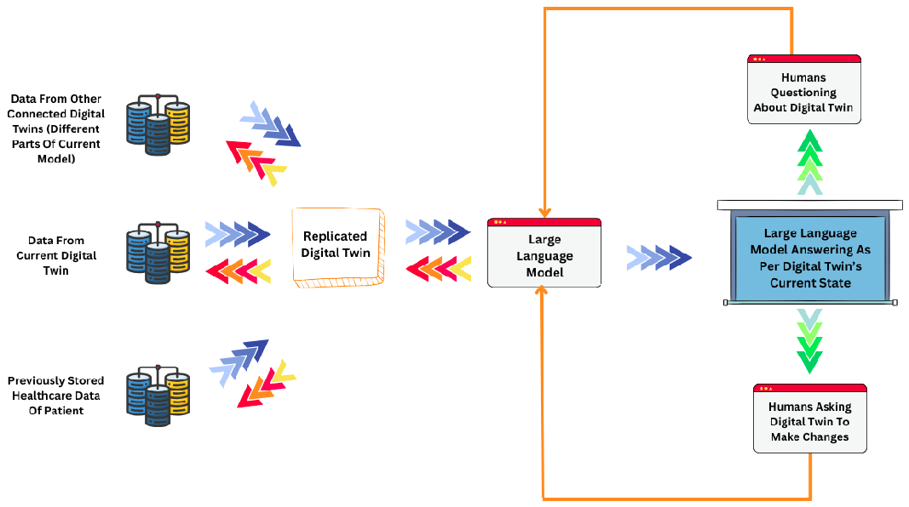
The Data Management

Slide 9
Applications
The proposed technology can be utilized in pharmaceutical research for experimenting with different medicines and vaccines and getting feedback based on the effects on the DT.
The proposed technology can also be utilized in precision medicine to set the dosage of any medicine according to the patient’s immune system. With the help of this technology, one can know how a medicine is affecting the patient and can change the dosage of that medicine instead of using the current methodology in which these types of experiments are performed on the patient itself.
The proposed technology can also be utilized in the healthcare industry for the curation of life-threatening diseases such as Parkinson's, cancer, Alzheimer's, etc.
The proposed technology can also be utilized for studying the workings of the brain, nervous system, immune system, and many other important parts of the human body and other living organisms.

Slide 10
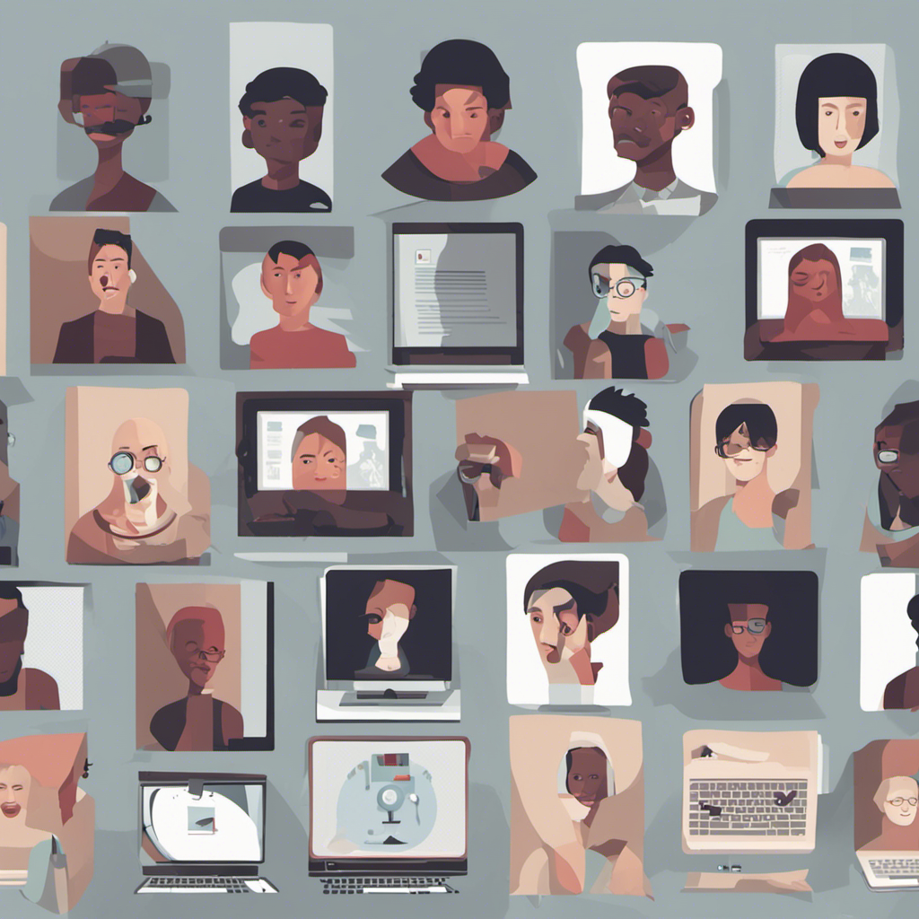
Future Scope
In this work, We have presented idea of state-of-the-art technology that is a combination of a digital twin and a large language model. Future research direction can be in implementation of it for different ethical use cases for the benefit of society.
Another area of ​​research can be in the development and improvement of existing protocols, regulations, and ethical guidelines for the use of the proposed technology in precision healthcare. This includes developing standards for information security and data sharing and many other things.
Another research direction would be to integrate reinforcement learning with the proposed technology, which can learn by itself, so that the technology would also be able to deal with circumstances that did not happen earlier.

Slide 11
Any Questions?

Slide 12
Thank You

